Slide 1


Deep Neural Methods for Retrieval
Bhaskar Mitra
Principal Applied Scientist, Microsoft
PhD candidate, University College London
@UnderdogGeek

Slide 2
Topics
Last week
Fundamentals of learning to rank
This week
Deep neural methods for retrieval

Slide 3

Reading material
An Introduction to
Neural Information Retrieval
Foundations and Trends® in Information Retrieval
(December 2018)
Download PDF: http://bit.ly/fntir-neural
FREE COPIES

Slide 4
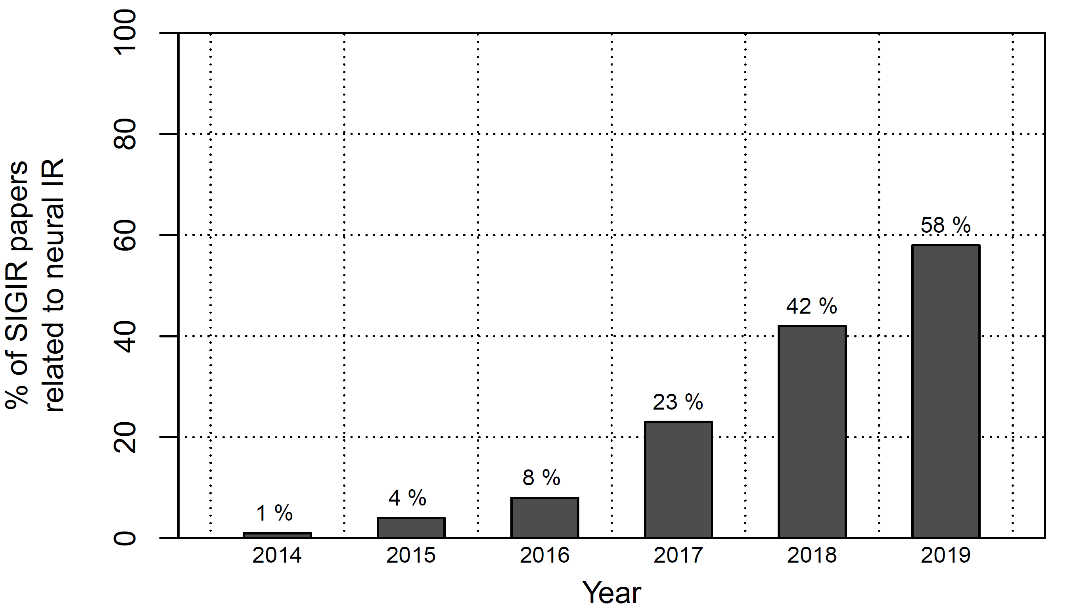
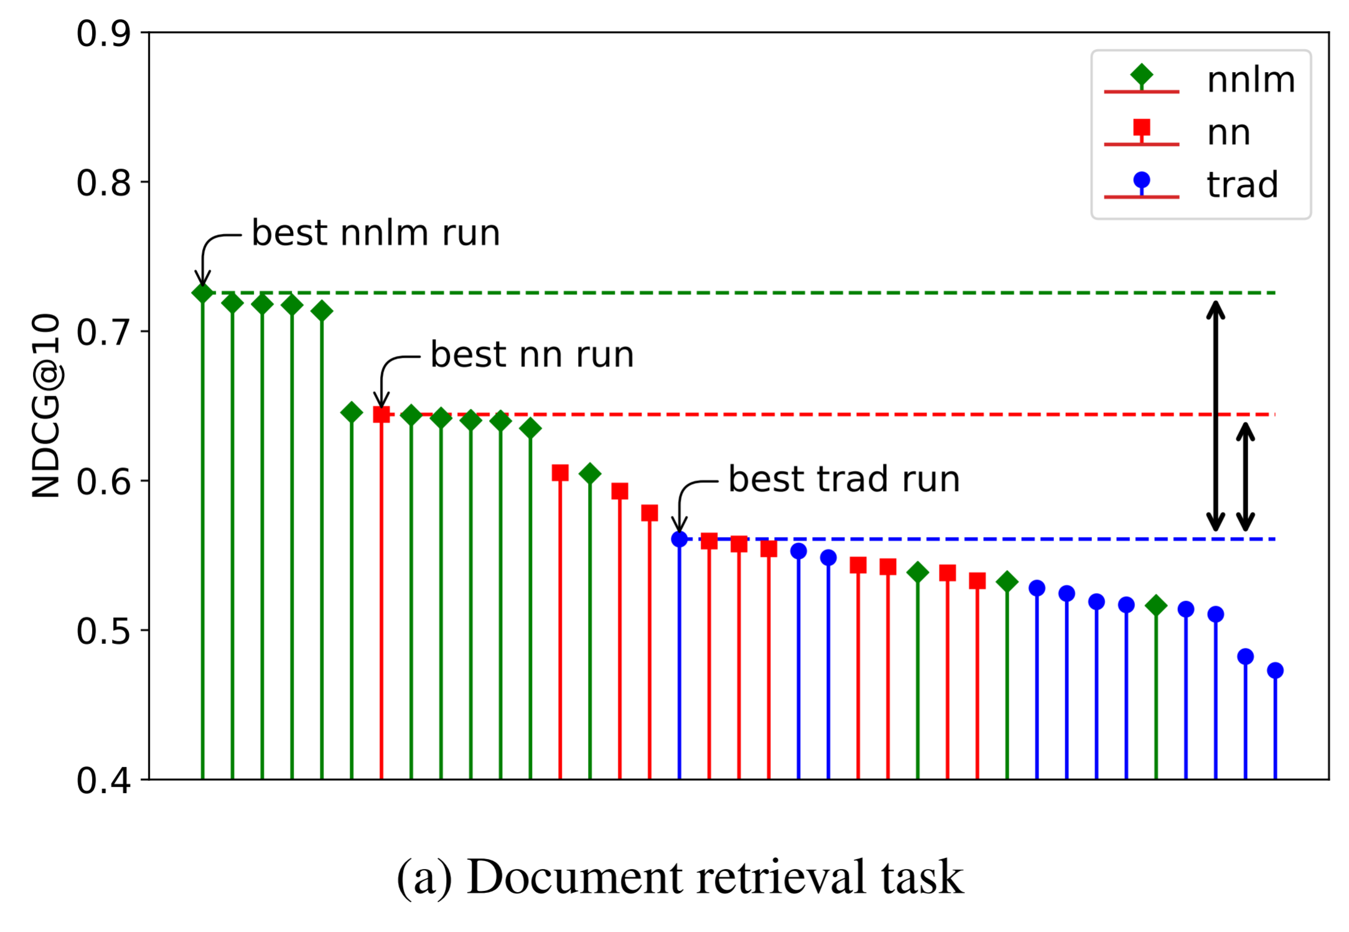
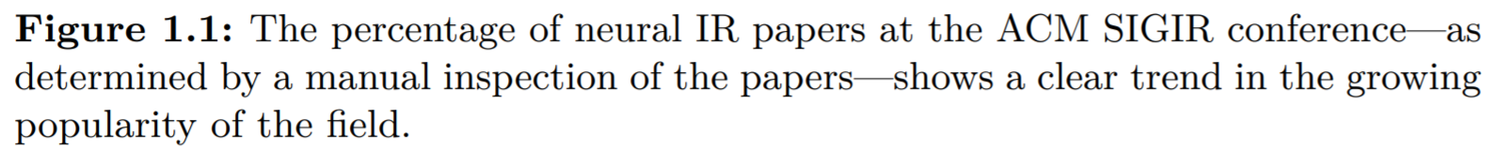
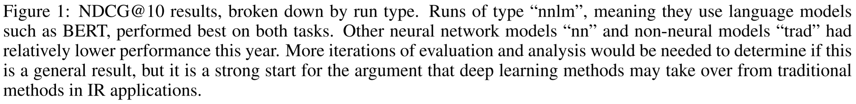
The state of neural information retrieval
Growing publication popularity at top IR conferences
Strong performance against traditional methods in TREC 2019

Slide 5
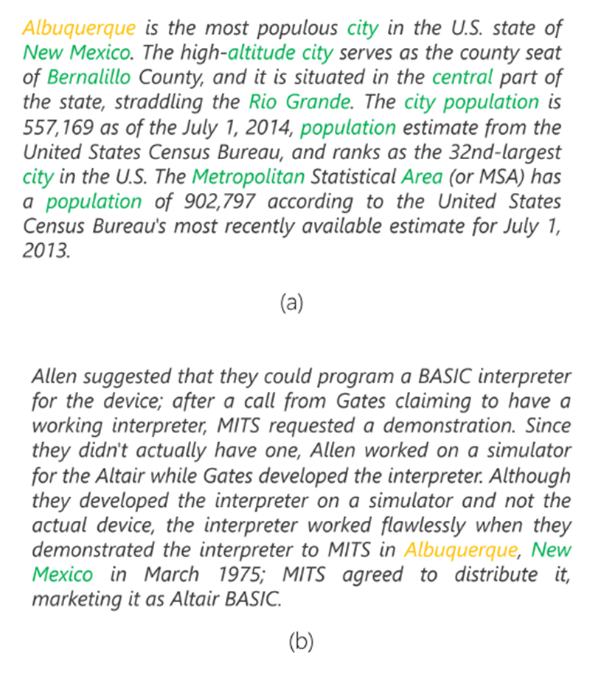
latent representation Learning for text
albuquerque
Passage about Albuquerque
Passage not about Albuquerque
Inspecting non-query terms in the document may reveal important clues about whether the document is relevant to the query

Slide 6
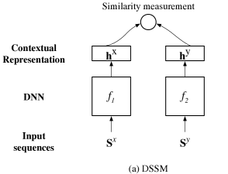
Deep Structured Semantic Model
Learn latent dense vector representation of query and document text
Relevance is estimated by cosine similarity between query and document embeddings
Relevant document embeddings should be more similar to query embeddings than non-relevant document embeddings
Po-Sen Huang, Xiaodong He, Jianfeng Gao, Li Deng, Alex Acero, and Larry Heck. Learning deep structured semantic models for web search using clickthrough data. In CIKM, 2013.

Slide 7
But how can we input text into a neural model?

Slide 8
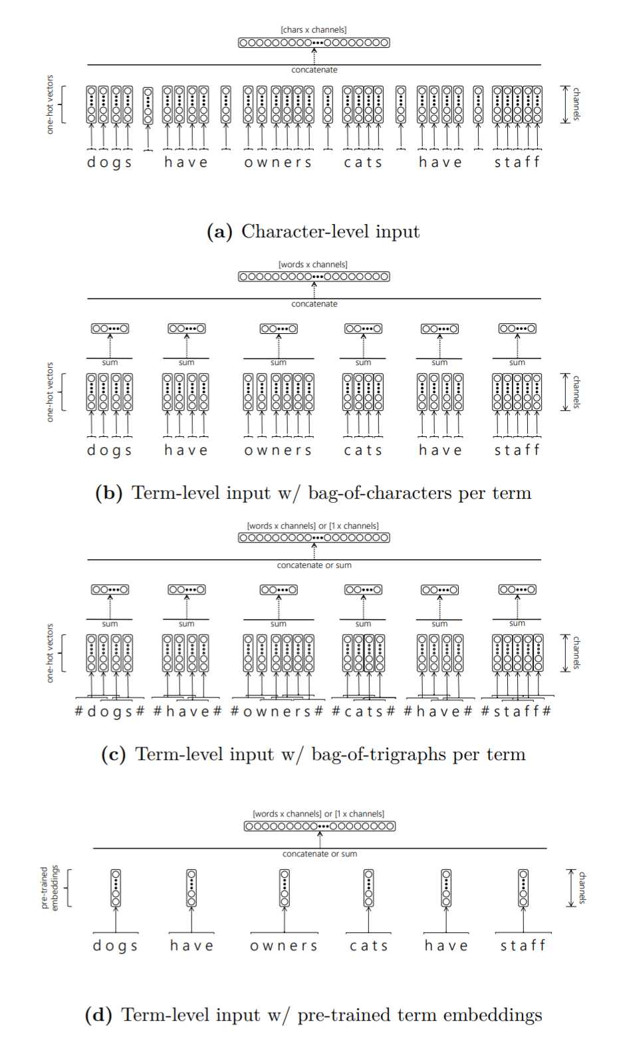
Different modalities of input text representation

Slide 9
Different modalities of input text representation

Slide 10
Different modalities of input text representation

Slide 11
Different modalities of input text representation

Slide 12
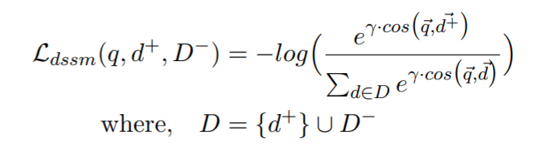
Deep Structured Semantic Model
To train the model we can use any of the loss functions we learned about in the last lecture
Cross-entropy loss against randomly sampled negative documents is commonly used
Po-Sen Huang, Xiaodong He, Jianfeng Gao, Li Deng, Alex Acero, and Larry Heck. Learning deep structured semantic models for web search using clickthrough data. In CIKM, 2013.

Slide 13
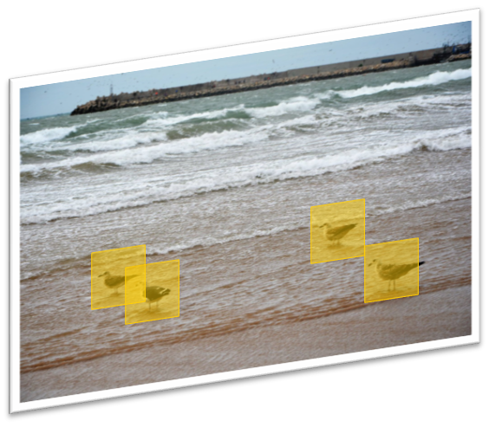
Shift-invariant neural operations
Detecting a pattern in one part of the input space is similar to detecting it in another
Leverage redundancy by moving a window over the whole input space and then aggregate
On each instance of the window a kernel—also known as a filter or a cell—is applied
Different aggregation strategies lead to different architectures

Slide 14
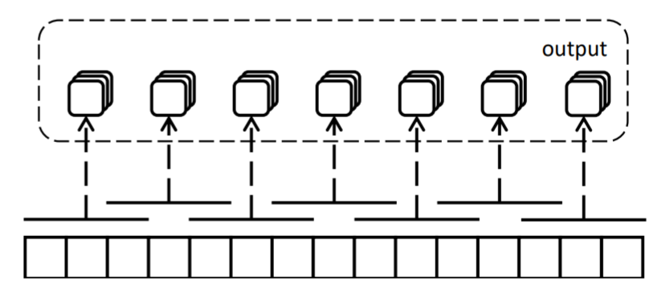
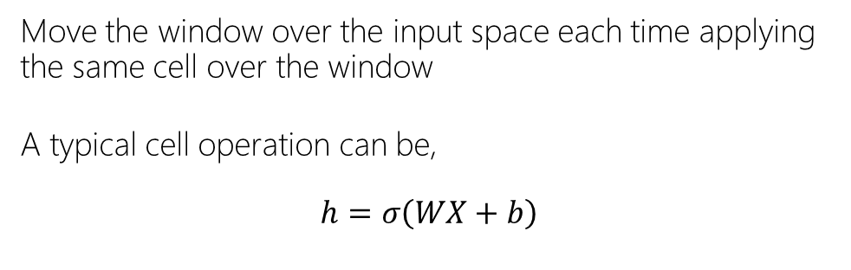
Convolution
Move the window over the input space each time applying the same cell over the window
A typical cell operation can be,
$$h=σ\left(WX+b\right)$$
Full Input | [words x in_channels]
Cell Input | [window x in_channels]
Cell Output | [1 x out_channels]
Full Output | [1 + (words – window) / stride x out_channels]

Slide 15
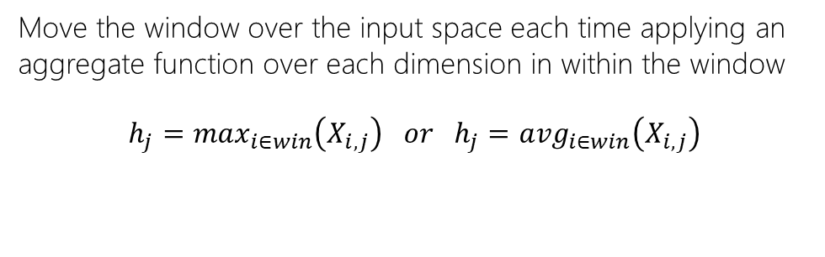
Pooling
Move the window over the input space each time applying an aggregate function over each dimension in within the window
$$h_{j}=\max_{i∈win}\left(X_{i,j}\right) or h_{j}={avg}_{i∈win}\left(X_{i,j}\right)$$
max -pooling
average -pooling
Full Input | [words x channels]
Cell Input | [window x channels]
Cell Output | [1 x channels]
Full Output | [1 + (words – window) / stride x channels]

Slide 16
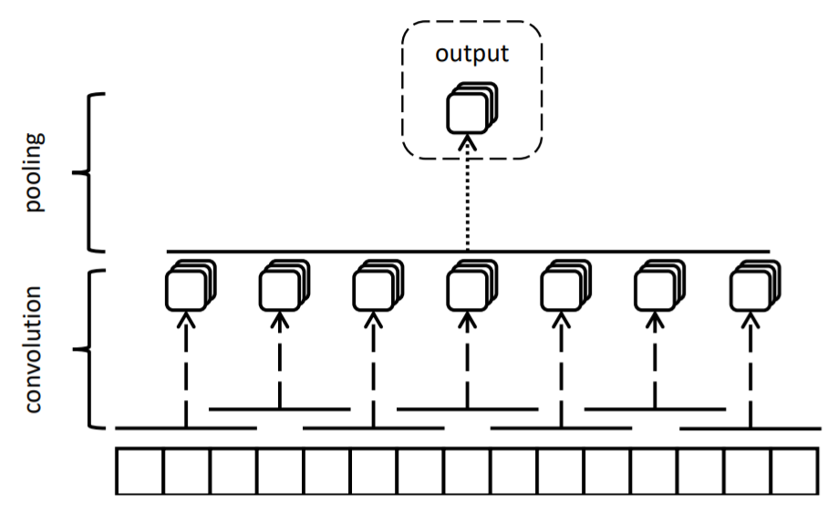
Convolution w/ Global Pooling
Stacking a global pooling layer on top of a convolutional layer is a common strategy for generating a fixed length embedding for a variable length text
Full Input | [words x in_channels]
Full Output | [1 x out_channels]

Slide 17
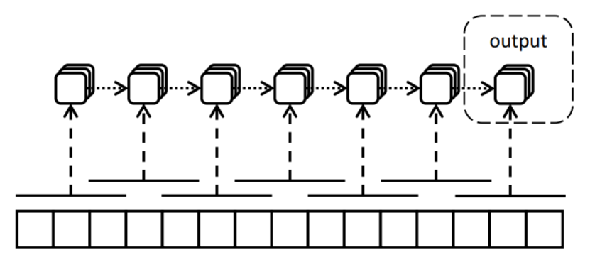
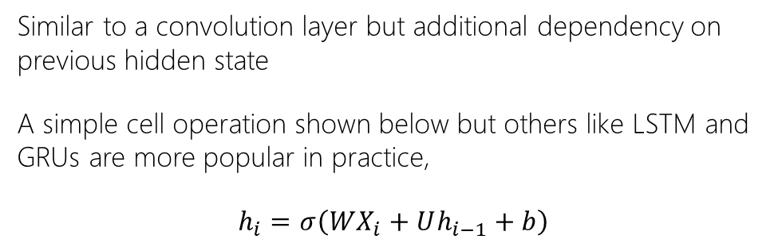
Recurrence
Similar to a convolution layer but additional dependency on previous hidden state
A simple cell operation shown below but others like LSTM and GRUs are more popular in practice,
$$h_{i}=σ\left(WX_{i}+Uh_{i−1}+b\right)$$
Full Input | [words x in_channels]
Cell Input | [window x in_channels] + [1 x out_channels]
Cell Output | [1 x out_channels]
Full Output | [1 x out_channels]

Slide 18
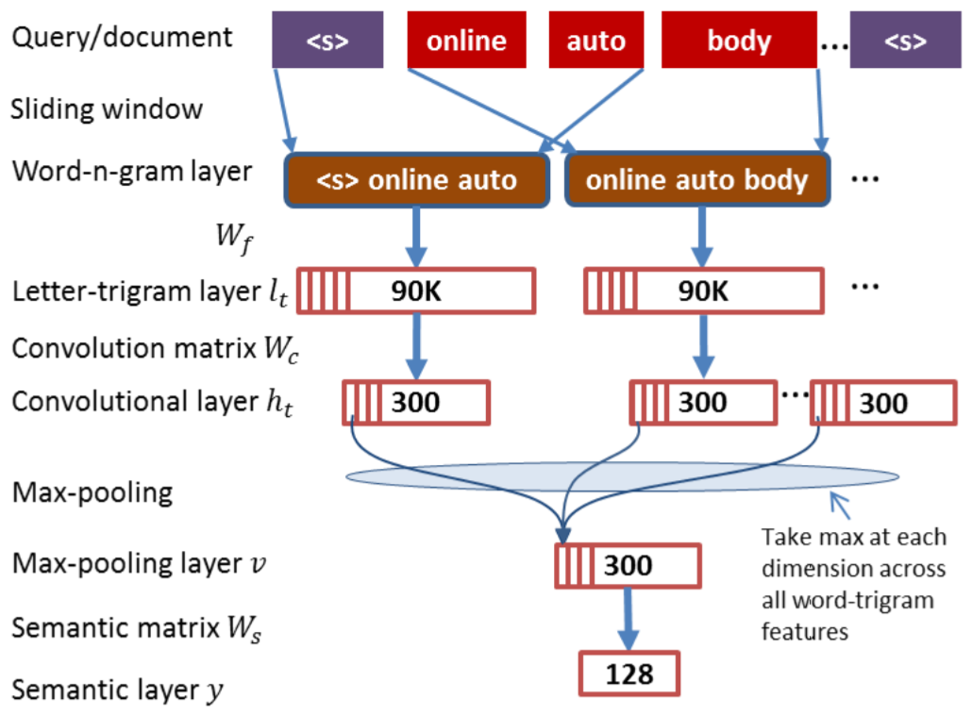
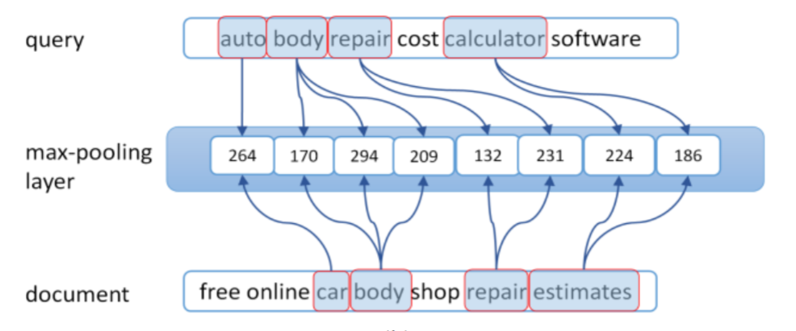
Convolutional DSSM (CDSSM)
Replace bag-of-words assumption by concatenating term vectors in a sequence on the input
Convolution followed by global max-pooling
Yelong Shen, Xiaodong He, Jianfeng Gao, Li Deng, and Gregoire Mesnil. A latent semantic model with convolutional-pooling structure for information retrieval. In CIKM, 2014.

Slide 19
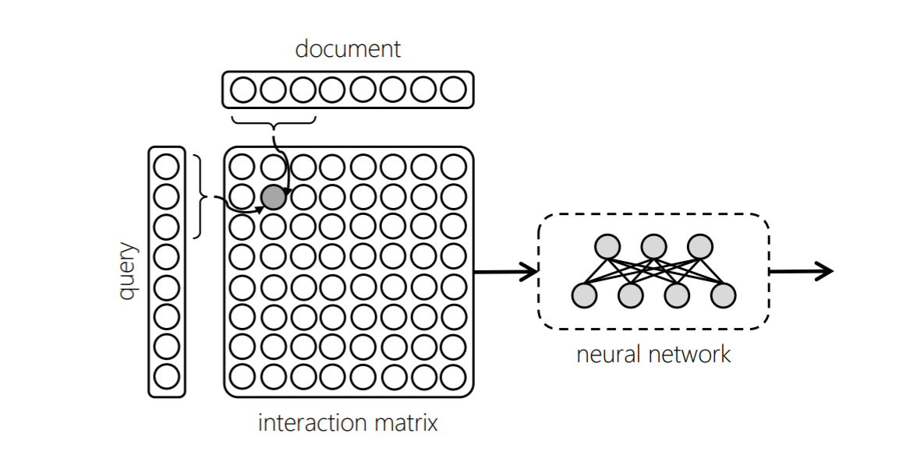
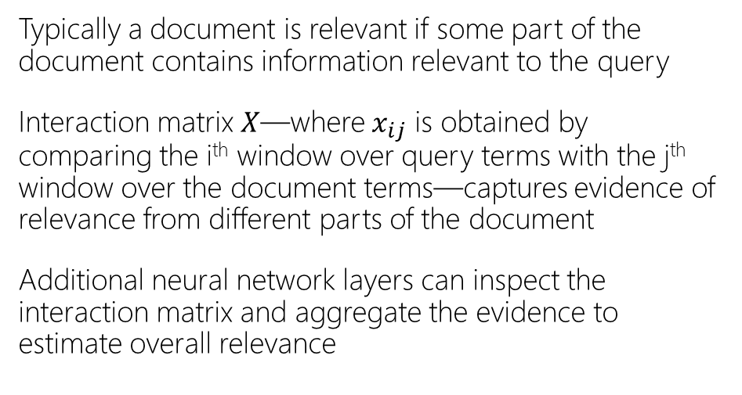
Interaction-based networks
Typically a document is relevant if some part of the document contains information relevant to the query
Interaction matrix $X$—where $x_{ij}$ is obtained by comparing the i^{th} window over query terms with the j^{th} window over the document terms—captures evidence of relevance from different parts of the document
Additional neural network layers can inspect the interaction matrix and aggregate the evidence to estimate overall relevance
Zhengdong Lu and Hang Li. A deep architecture for matching short texts. In NIPS, 2013.

Slide 20
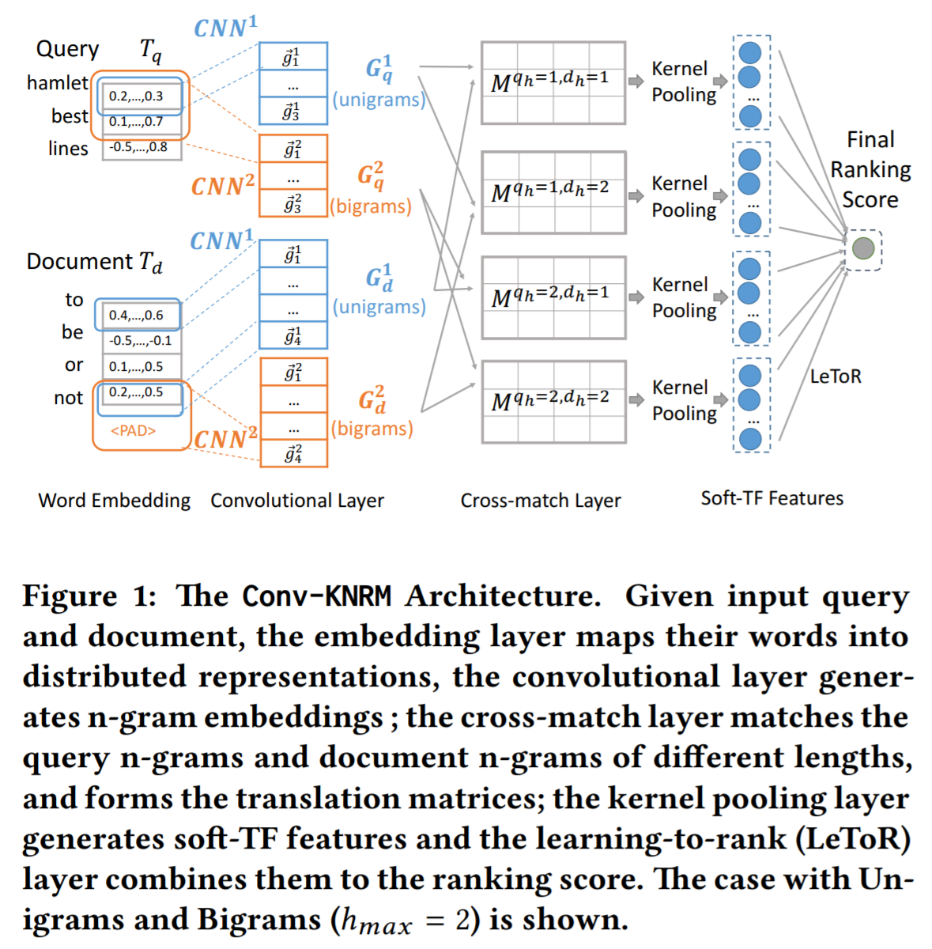
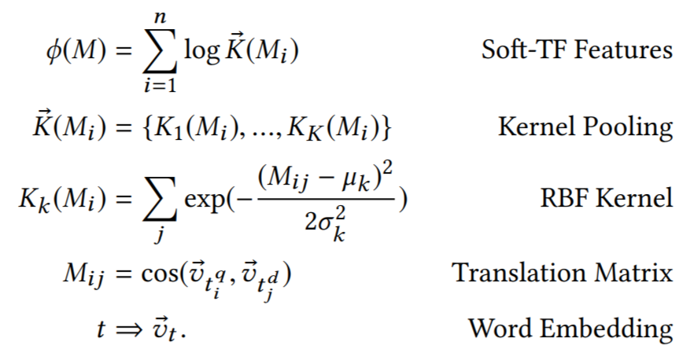
Kernel pooling
Chenyan Xiong, Zhuyun Dai, Jamie Callan, Zhiyuan Liu, and Russell Power. End-to-end neural ad-hoc ranking with kernel pooling. In SIGIR, 2017.
Zhuyun Dai, Chenyan Xiong, Jamie Callan, and Zhiyuan Liu. Convolutional neural networks for soft-matching n-grams in ad-hoc search. In WSDM, 2018.

Slide 21
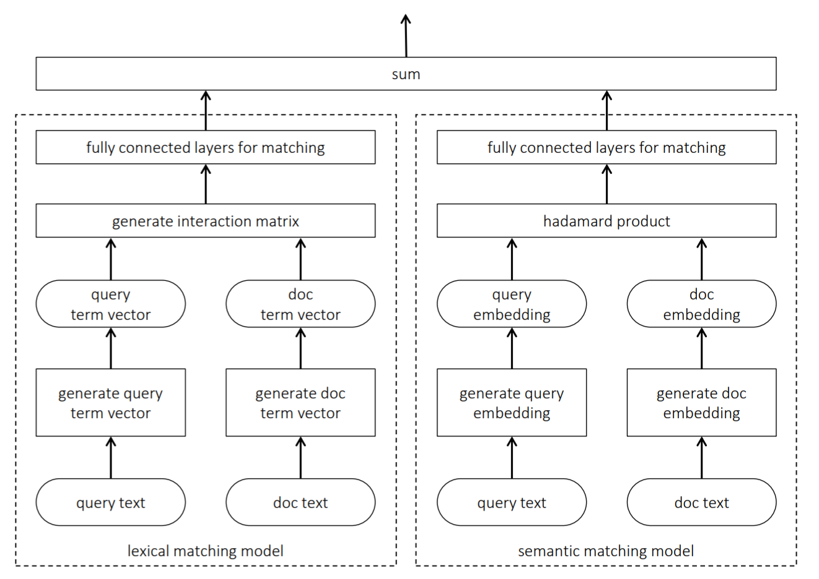
Lexical and semantic matching networks
Mitra et al. [2016] argue that both lexical and semantic matching is important for document ranking
Duet model is a linear combination of two DNNs—focusing on lexical and semantic matching, respectively—jointly trained on labelled data
Bhaskar Mitra, Fernando Diaz, and Nick Craswell. Learning to match using local and distributed representations of text for web search. In WWW, 2017.

Slide 22
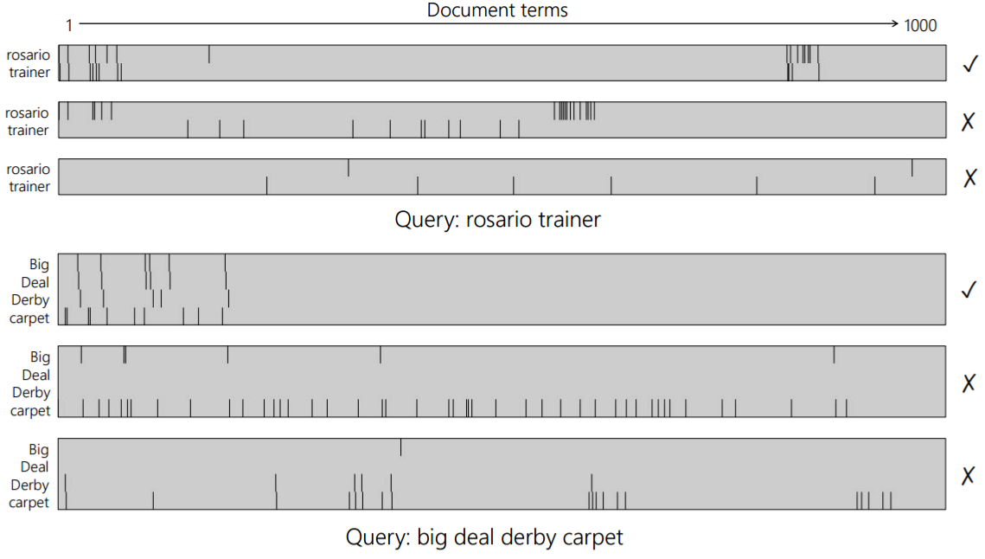
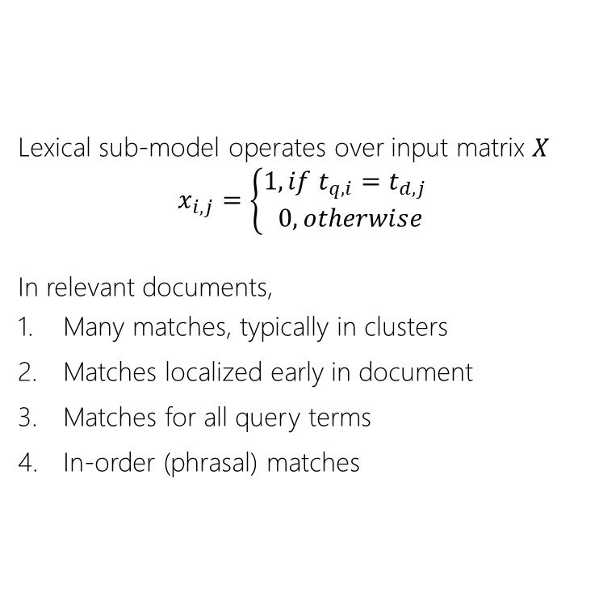
Lexical and semantic matching networks
Lexical sub-model operates over input matrix $X$
$$x_{i,j}=\left\{\begin{aligned}1, if t_{q,i}=t_{d,j} \\ 0, otherwise\end{aligned}\right.$$
In relevant documents,
Many matches, typically in clusters
Matches localized early in document
Matches for all query terms
In-order (phrasal) matches
Bhaskar Mitra, Fernando Diaz, and Nick Craswell. Learning to match using local and distributed representations of text for web search. In WWW, 2017.

Slide 23
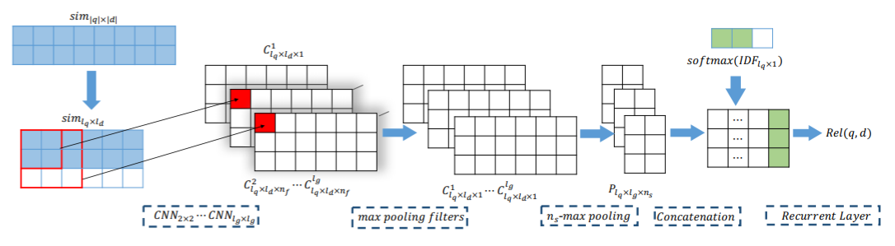
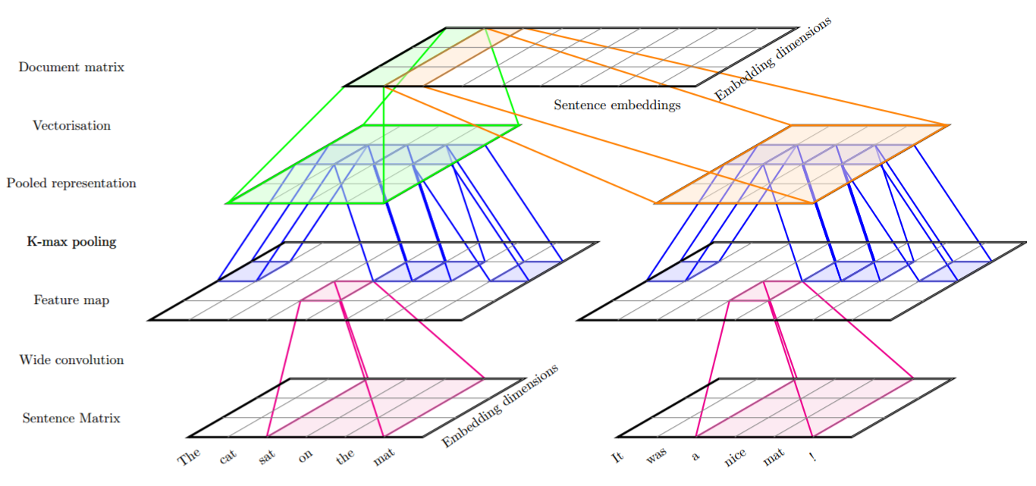
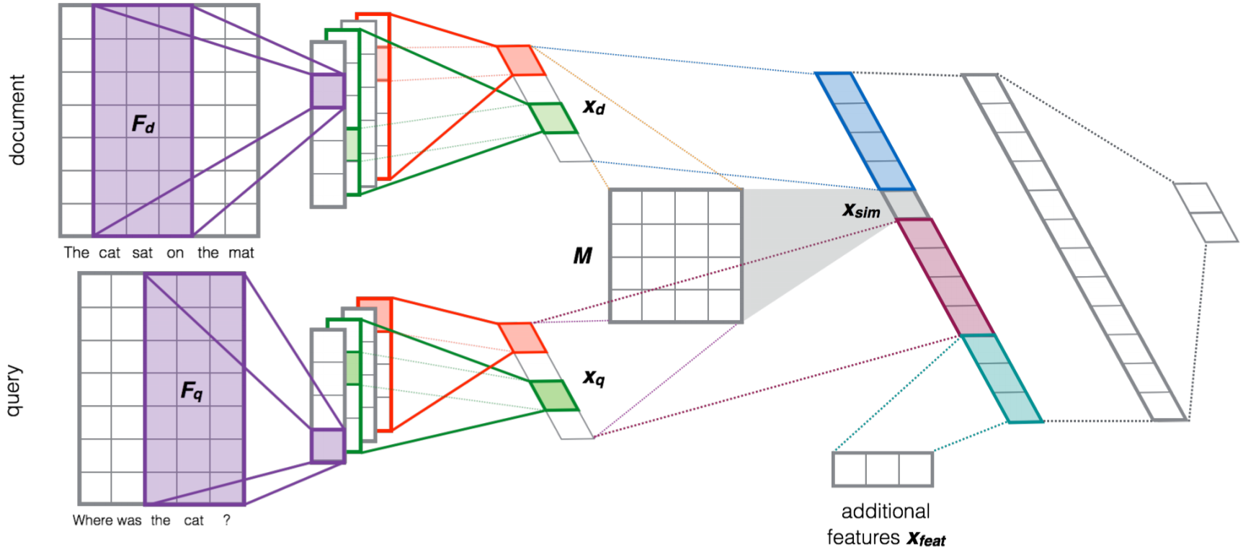
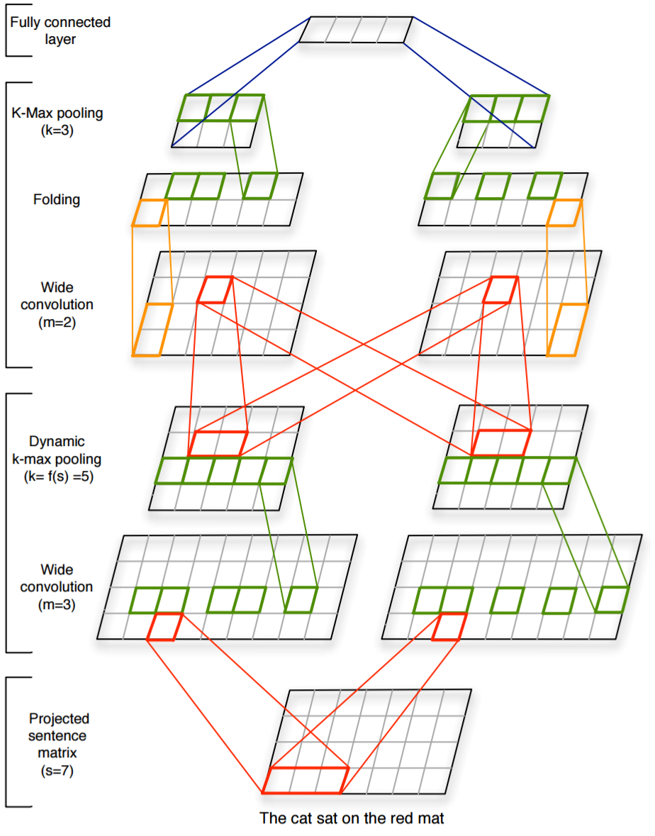
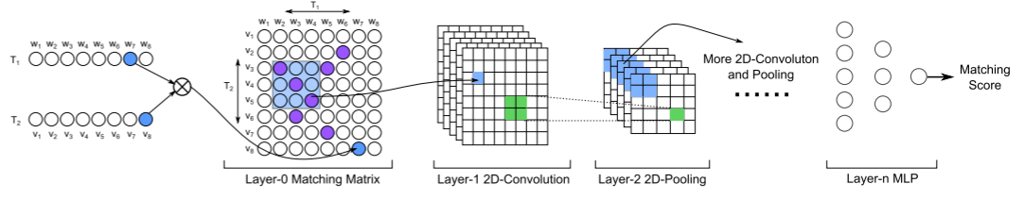
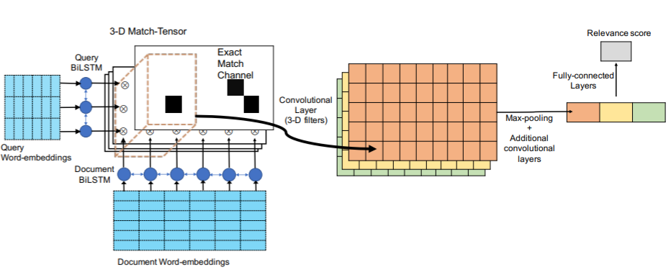
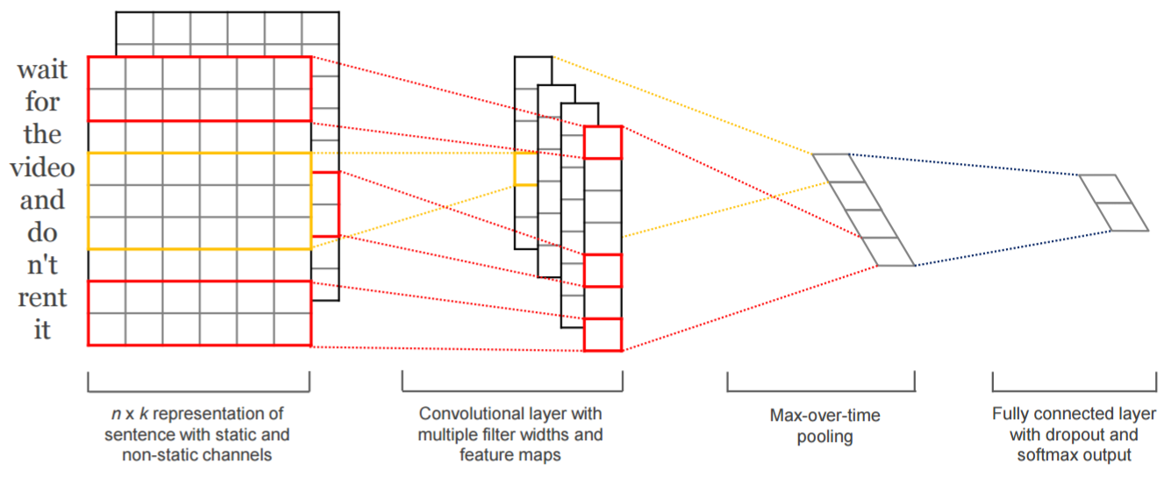
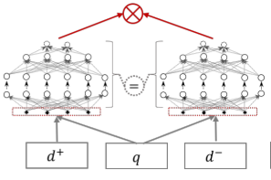
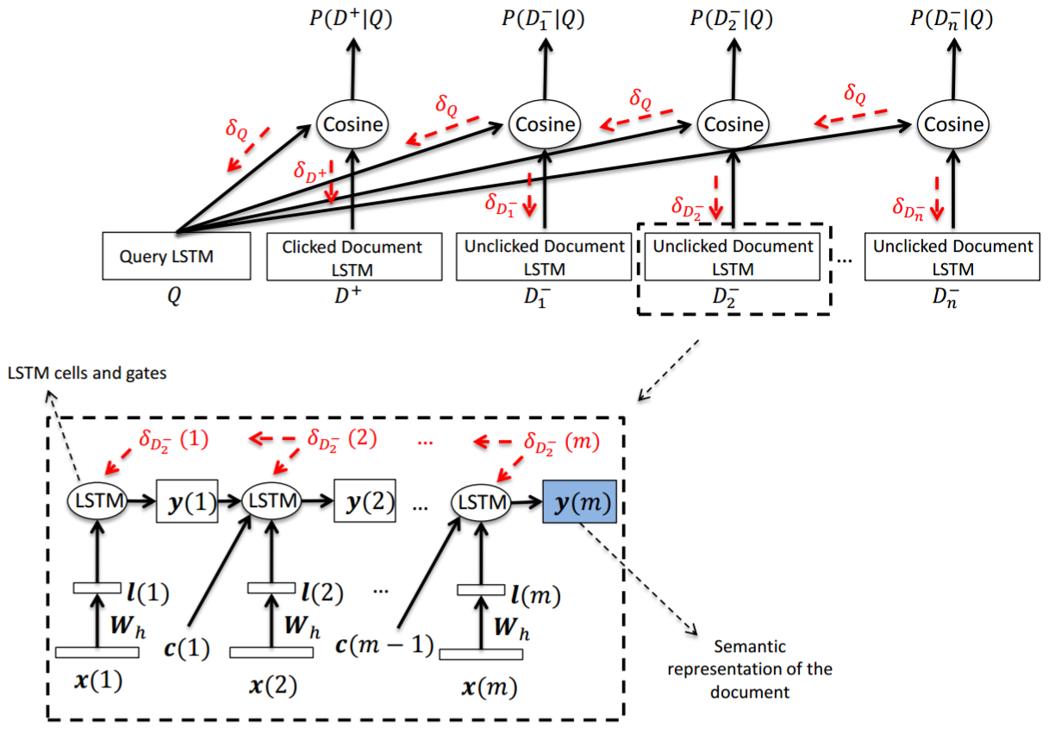
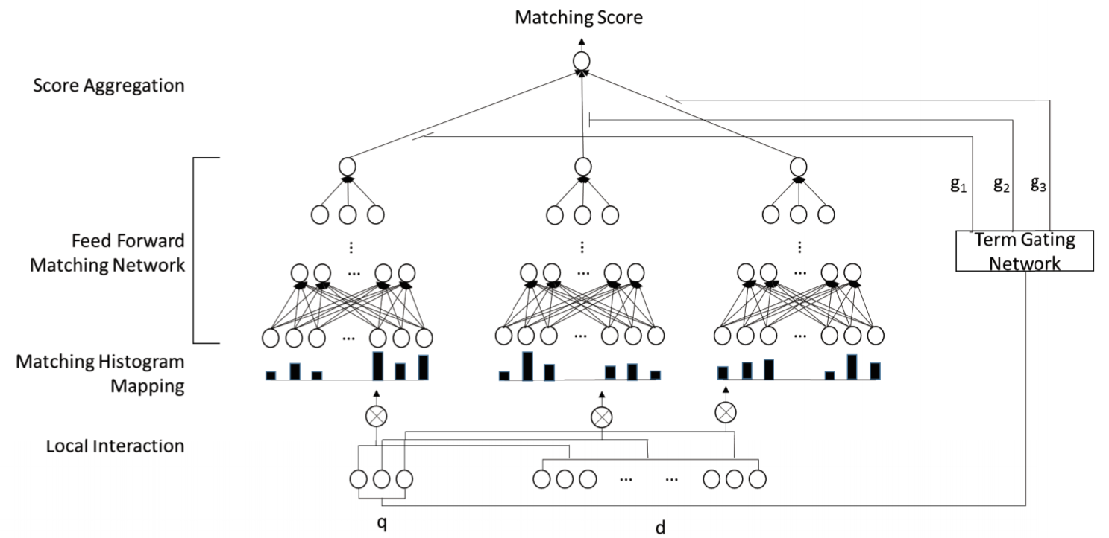
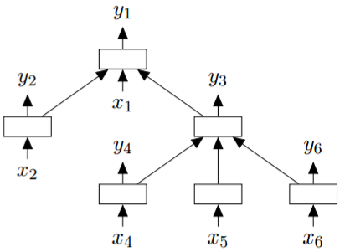
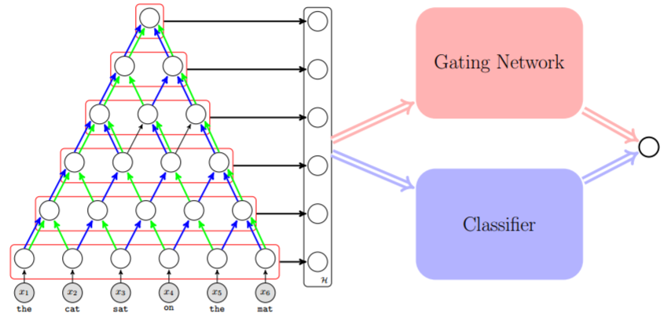
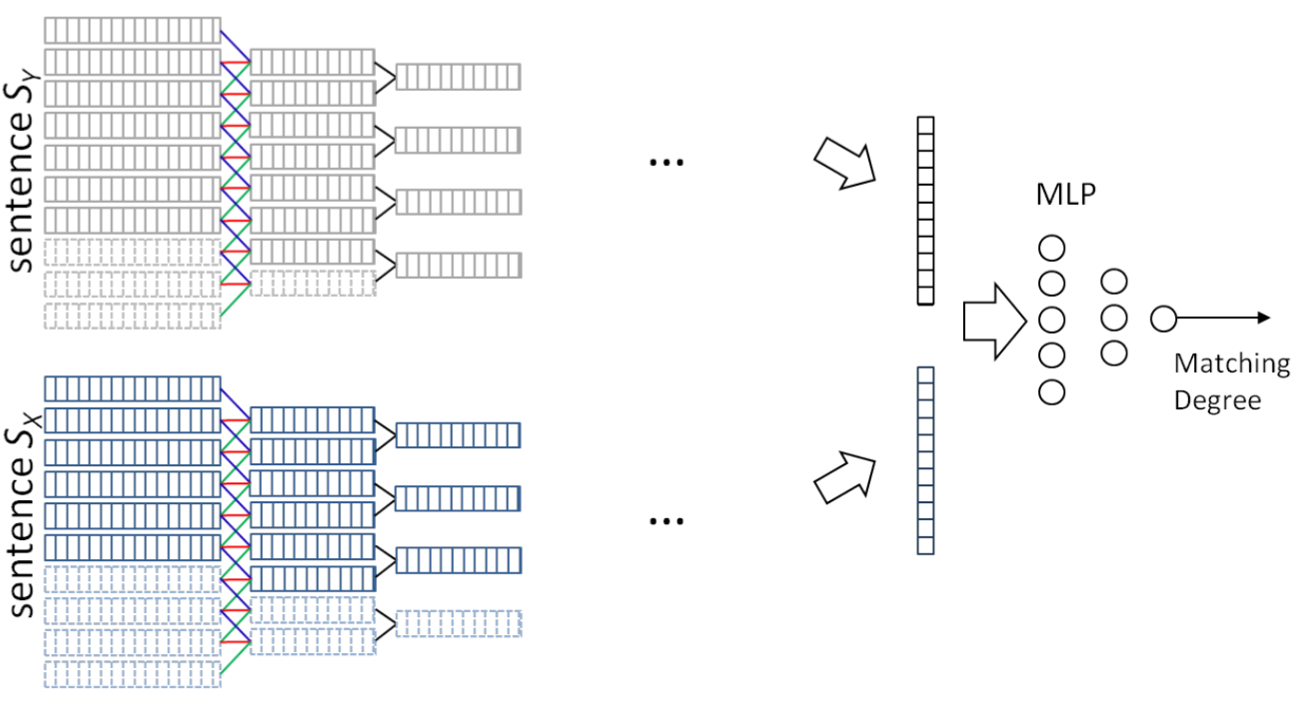
Many other neural architectures
(Hui et al., 2017)
(Pang et al., 2017)
(Denil et al., 2014)
(Severyn and Moschitti, 2015)
(Jaech et al., 2017)
(Kalchbrenner et al., 2014)
(Dehghani et al., 2017)
(Kim, 2014)
(Guo et al., 2016)
(Zhao et al., 2015)
(Palangi et al., 2015)
(Hu et al., 2014)
(Tai et al., 2015)

Slide 24
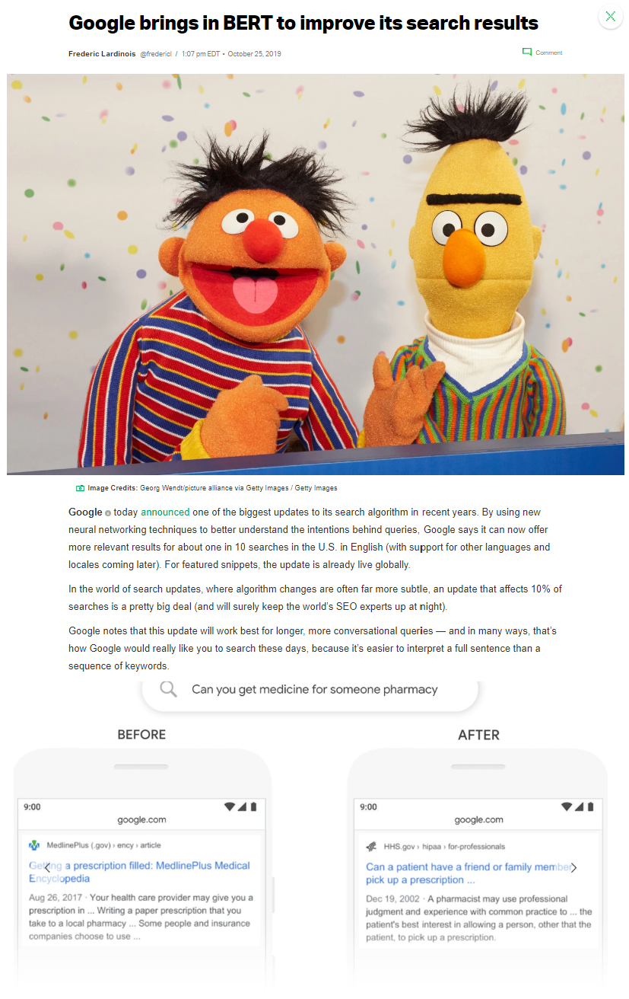

BERT for Ranking
Impact across both academia and industry

Slide 25
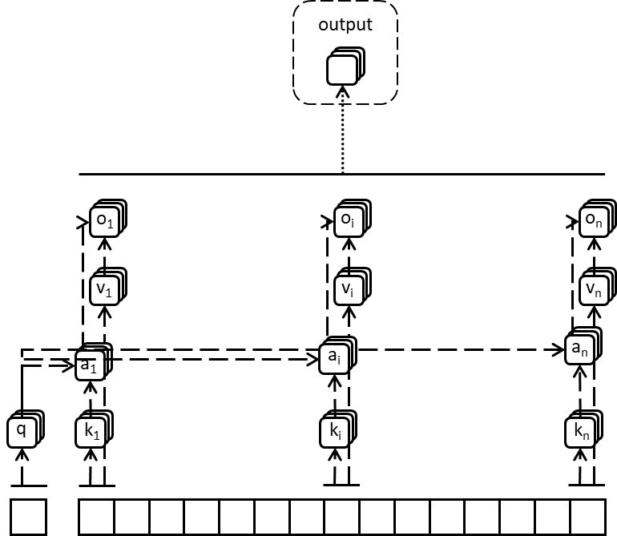
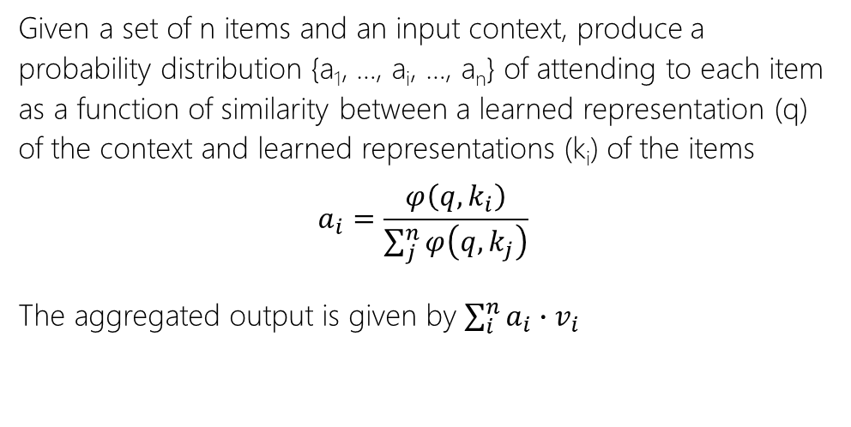
Attention
Given a set of n items and an input context, produce a probability distribution {a₁, …, a_{i}, …, a_{n}} of attending to each item as a function of similarity between a learned representation (q) of the context and learned representations (k_{i}) of the items
$$a_{i}=\frac{φ\left(q, k_{i}\right)}{\sum_{j}^{n}{φ\left(q, k_{j}\right)}}$$
The aggregated output is given by $\sum_{i}^{n}{a_{i}∙v_{i}}$
Full Input | [words x in_channels], [1 x ctx_channels]
Full Output | [1 x out_channels]
* When attending over a sequence (and not a set), the key k and value v are typically a function of the item and some encoding of the position

Slide 26
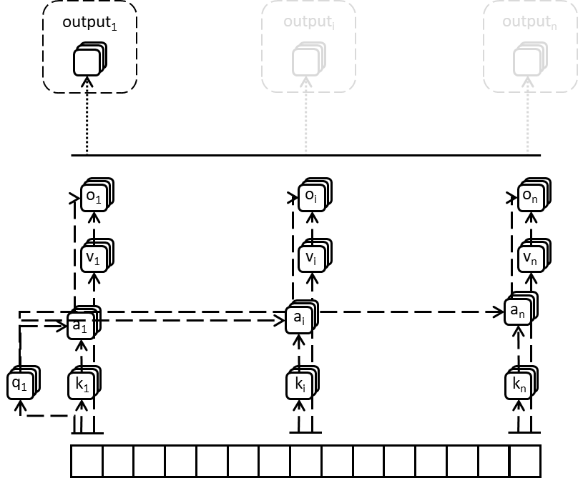
Self attention
Given a sequence (or set) of n items, treat each item as the context at a time and attend over the whole sequence (or set), and repeat for all n items
Full Input | [words x in_channels]
Full Output | [words x out_channels]

Slide 27
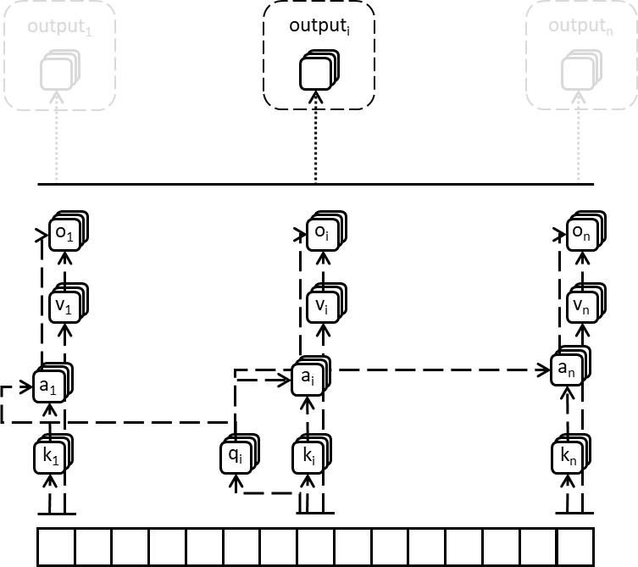
Self attention
Given a sequence (or set) of n items, treat each item as the context at a time and attend over the whole sequence (or set), and repeat for all n items
Full Input | [words x in_channels]
Full Output | [words x out_channels]

Slide 28
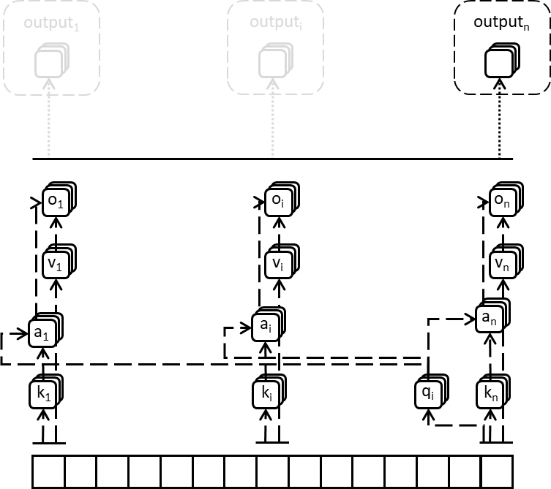
Self attention
Given a sequence (or set) of n items, treat each item as the context at a time and attend over the whole sequence (or set), and repeat for all n items
Full Input | [words x in_channels]
Full Output | [words x out_channels]

Slide 29
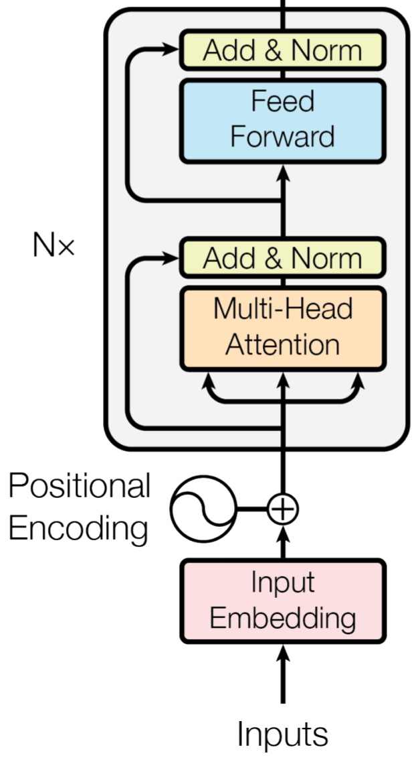
transformers
A transformer layer consists of a combination of self-attention layer and multiple fully-connected or convolutional layers, with residual connections
A transformer-based encoder can consist of multiple transformers stacked in sequence
Full Input | [words x in_channels]
Full Output | [words x out_channels]
Ashish Vaswani, Noam Shazeer, Niki Parmar, Jakob Uszkoreit, Llion Jones, Aidan N. Gomez, Łukasz Kaiser, and Illia Polosukhin. Attention is all you need. In NeurIPS, 2017.

Slide 30
language modeling
w₃
loss
A family of language modeling tasks have been explored in the literature, including:
Predict next word in a sequence
Predict masked word in a sequence
Predict next sentence
Fundamentally the same idea as word2vec and older neural LMs—but with deeper models and considering dependencies across longer distances between terms
?
model
w₁
w₂
[MASK]
w₄

Slide 31
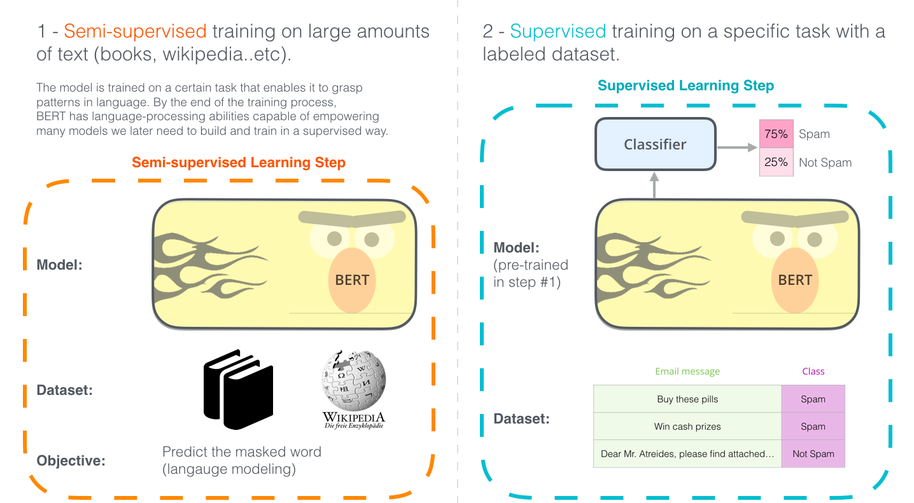
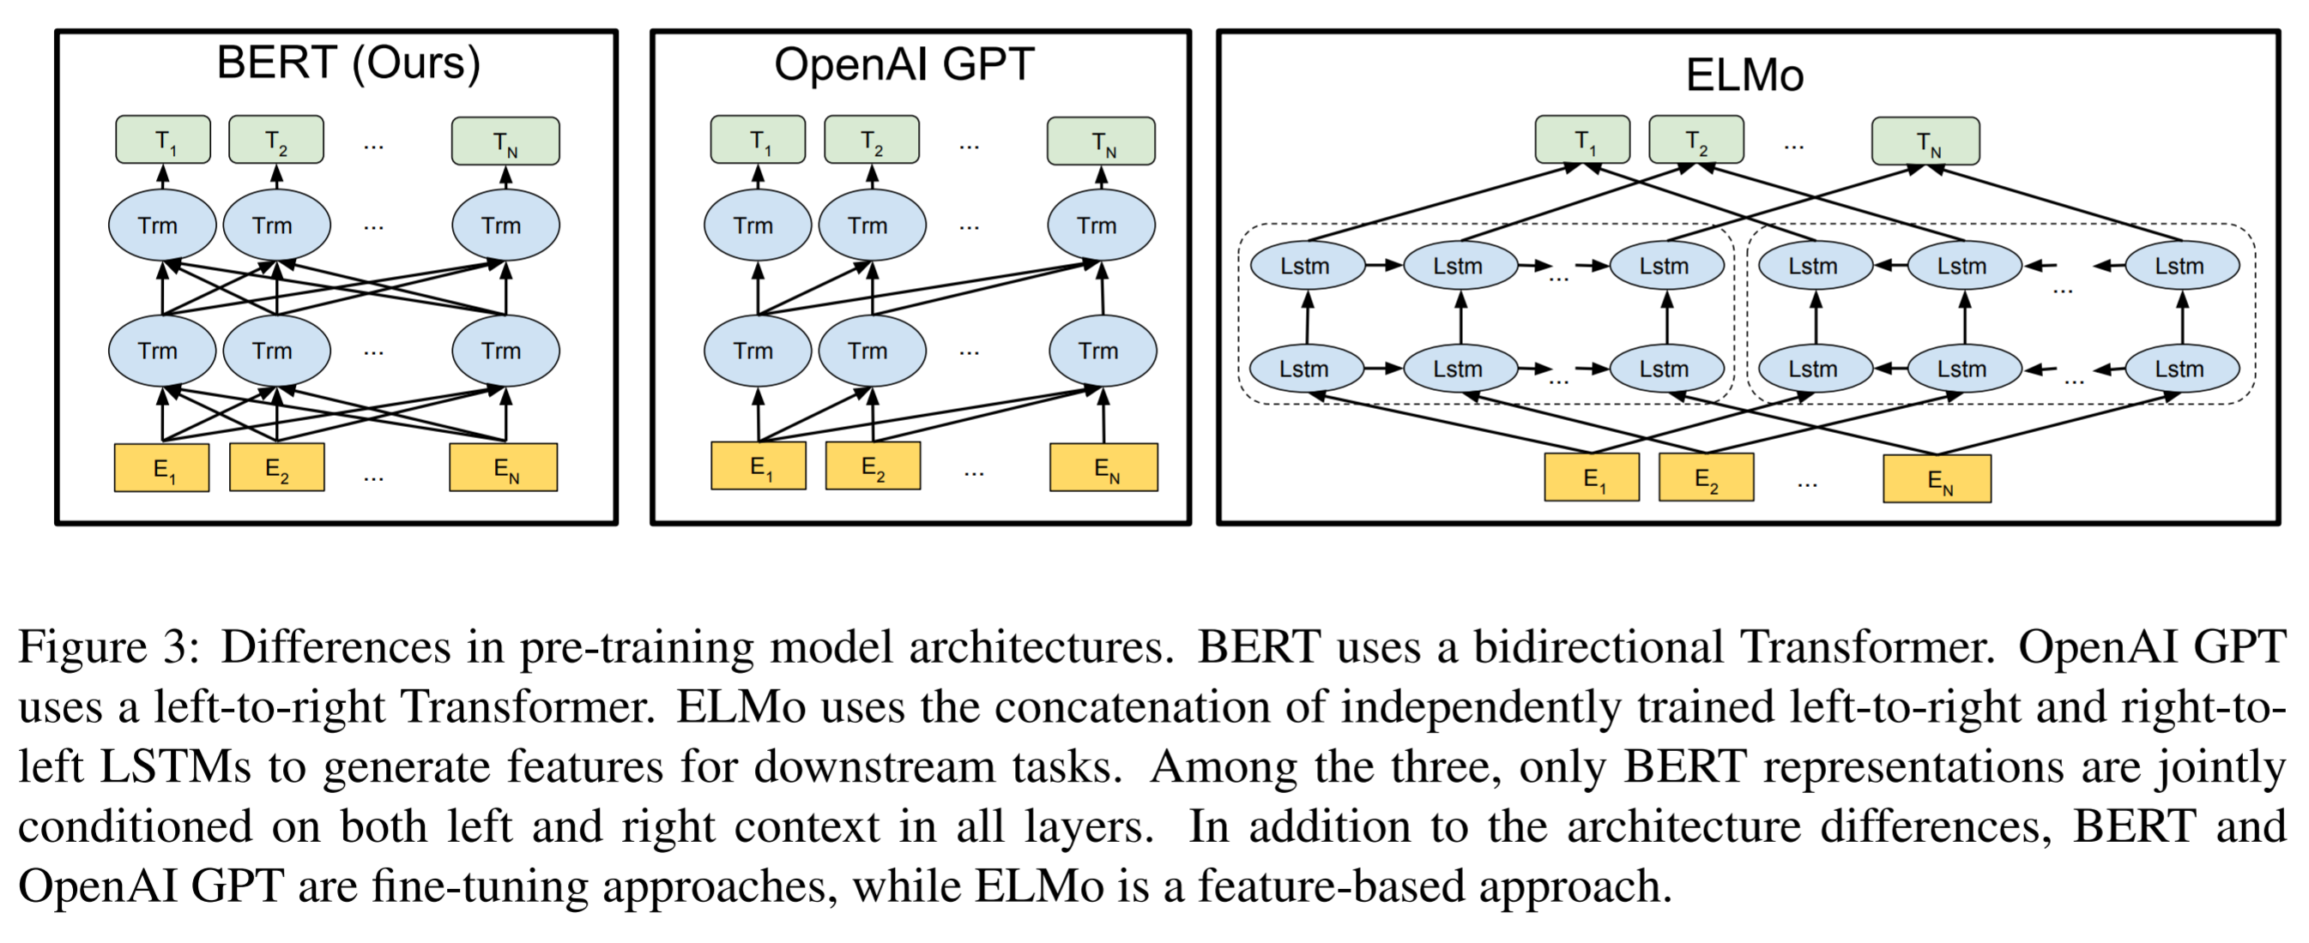
contextualized Deep word embeddings
http://jalammar.github.io/illustrated-bert/
Jacob Devlin, Ming-Wei Chang, et al. Bert: Pre-training of deep bidirectional transformers for language understanding. In NAACL, 2018.
Matthew E. Peters, Mark Neumann, Mohit Iyyer, Matt Gardner, Christopher Clark, Kenton Lee, and Luke Zettlemoyer. Deep contextualized word representations. In NAACL-HLT, 2018.

Slide 32
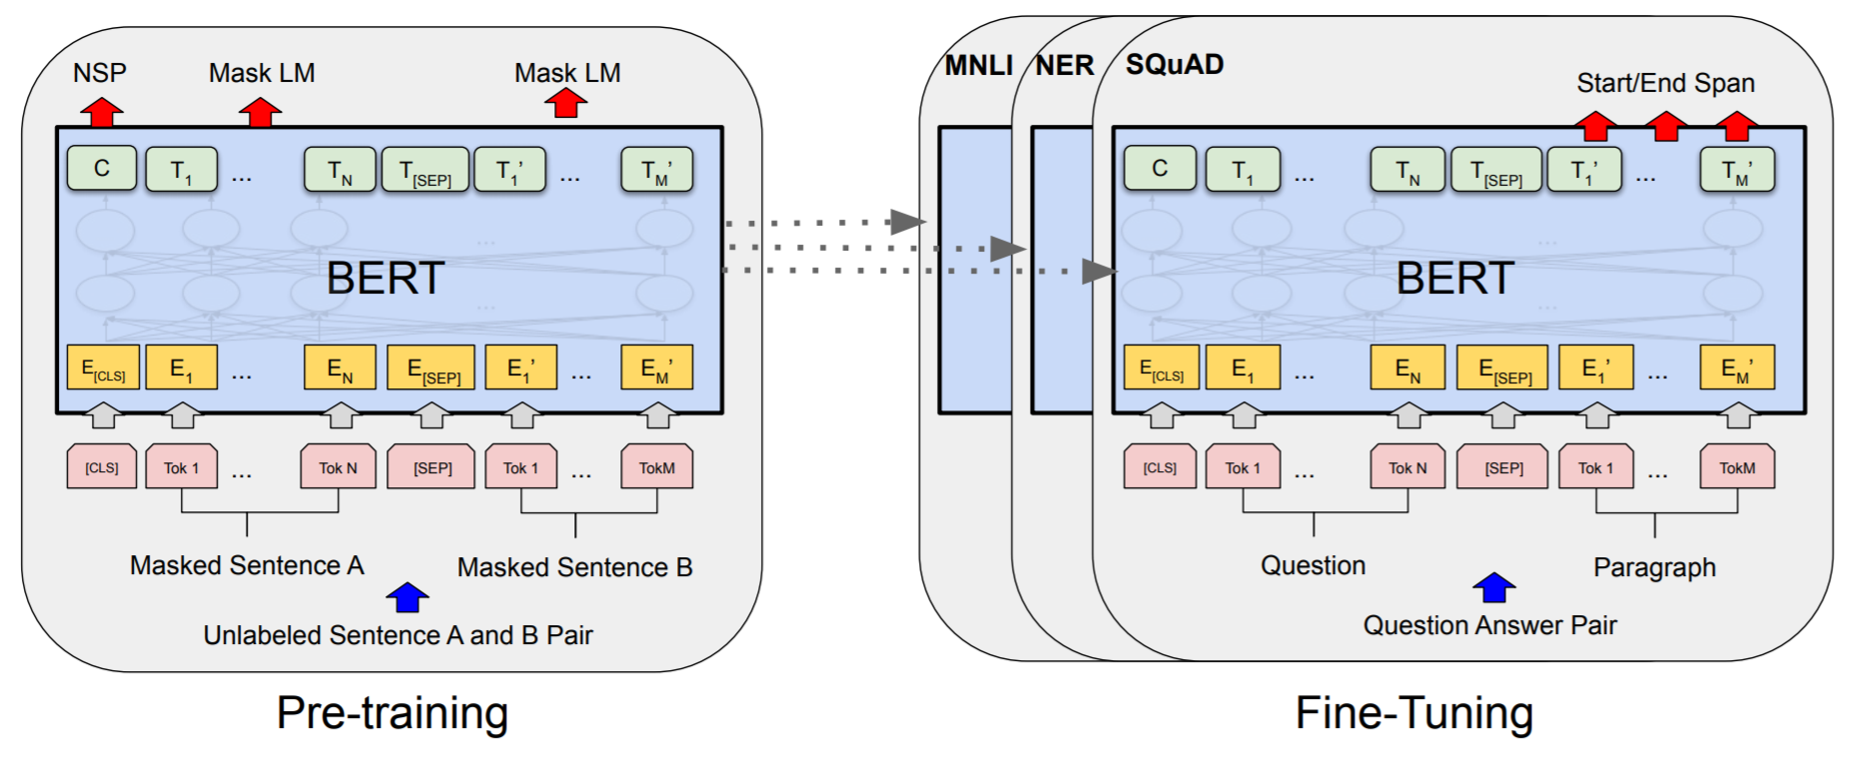
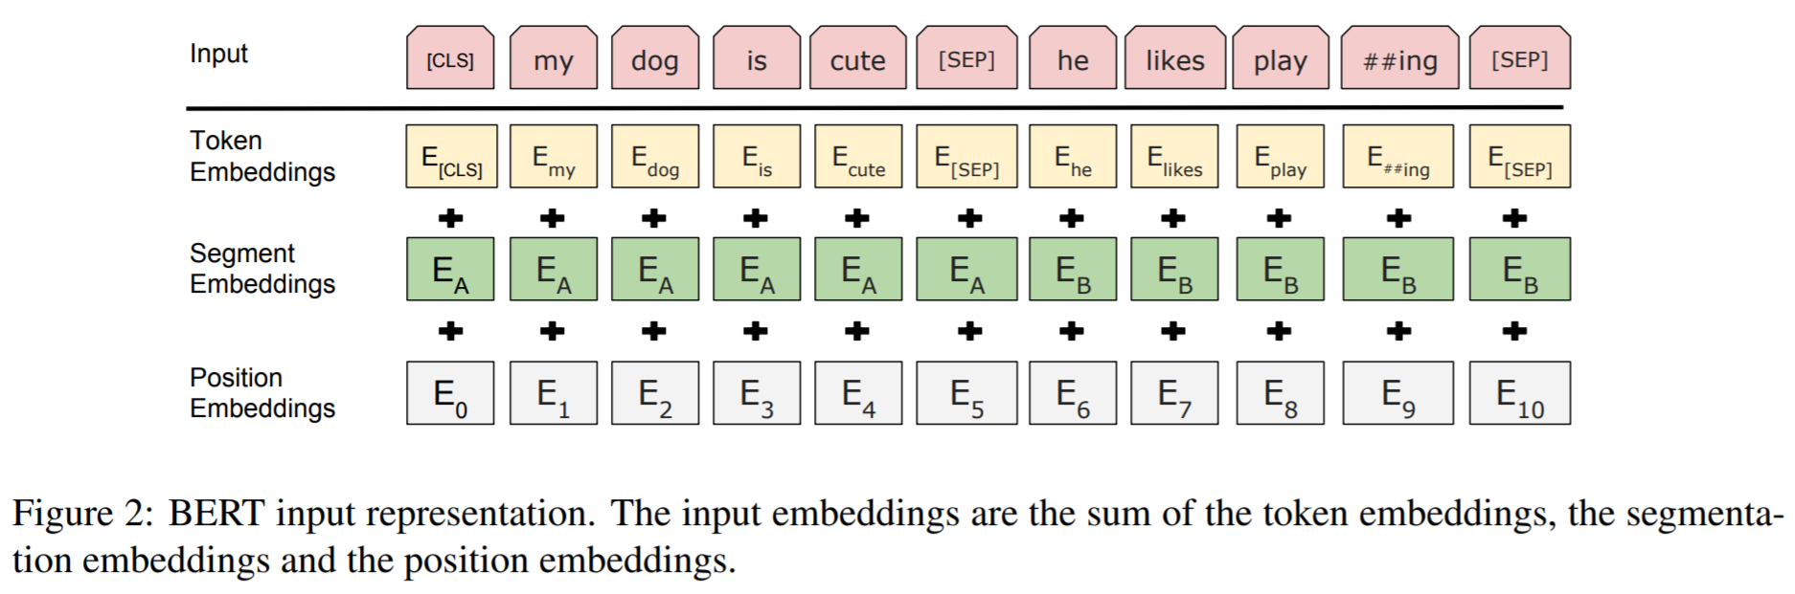
BERT
Stacked transformer layers
Pretrained on two tasks:
Masked language modeling
Next sentence prediction
Input: WordPiece embedding + position embedding + segment embedding
Jacob Devlin, Ming-Wei Chang, et al. Bert: Pre-training of deep bidirectional transformers for language understanding. In NAACL, 2018.

Slide 33
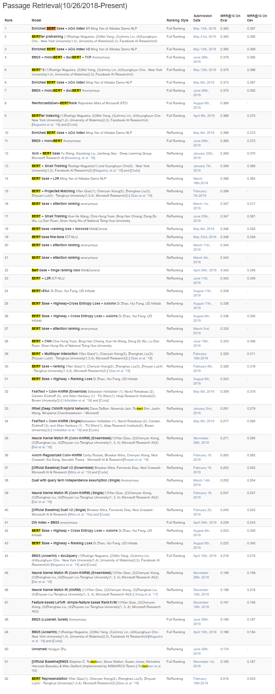






BERT for Ranking
BERT (and other large-scale unsupervised language models) are demonstrating dramatic performance improvements on many IR tasks
MS MARCO
score
Query
Passage
Query Passage Pair
Rodrigo Nogueira, and Kyunghyun Cho. Passage Re-ranking with BERT. In arXiv, 2019.

Slide 34
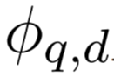

Retrieving, not just reranking, with deep neural networks
Deep ranking models are compute-intensive and are practically employed only to rerank top-k candidates retrieved by more efficient traditional IR methods
IR performances may be significantly more impacted if we can also use them for candidate generation
score

Slide 35
Option 1: Query independent document representation
Employ a Siamese network architecture
Compute document representations offline and query representation at inference time
Efficient online but large offline computation cost
Effectiveness degrades without interaction features and lexical term matching
score

Slide 36


Fast approx. k-NN search with ANNOY
https://github.com/spotify/annoy

Slide 37

Option 2: Assume query term independence assumption
Efficient online but large offline computation cost
Can scale to tail queries but at higher computation cost—we can trade-off the two experimentally
Bhaskar Mitra et al. Incorporating Query Term Independence Assumption for Efficient Retrieval and Ranking using Deep Neural Networks. In arXiv, 2019.

Slide 38


What did your model really learn?
While we celebrate the recent performance bumps on IR tasks from neural methods, it is also important to recognize when and how they fail

Slide 39

Clever Hans was a horse claimed to have been capable of performing arithmetic and other intellectual tasks.
"If the eighth day of the month comes on a Tuesday, what is the date of the following Friday?“
Hans would answer by tapping his hoof.
In fact, the horse was purported to have been responding directly to involuntary cues in the body language of the human trainer, who had the faculties to solve each problem. The trainer was entirely unaware that he was providing such cues.
(source: Wikipedia)
Notes:
Clever Hans was a horse. It was claimed that he could do simple arithmetic. If you asked Hans a question he would respond by tapping his hoof. After a thorough investigation, it was, however, determined that what Clever Hans was really good at was at reading very subtle and, in fact, unintentional clues that his trainer was giving him via his body language. Hans didn’t know arithmetic at all. But he was very good at spotting body language that CORRELATED highly with the right answer.

Slide 40
BM25
What corpus statistics does your model depend on?
vs.
BERT
(
)
(
)
Inverse document frequency of terms
Language model of term co-occurrences
Notes:
A traditional IR model, such as BM25, makes very few assumptions about the target collection. You can argue that the inverse document frequencies (and couple of the BM25 hyper-parameters) are all that you would learn from your collection. Which is why you can throw BM25 at most retrieval task (e.g., TREC or Web ranking in Bing) and it would give you pretty reasonable performance in most cases out-of-the-box. On the other hand, take a deep neural model and train it on Bing Web ranking task and then evaluate it on TREC data and I bet it falls flat on its face.

Slide 41



What changed between train and test?
Query: uk prime minister
Terms often change meaning across domains or over time
Robust retrieval performance is important (e.g., enterprise search across multiple tenants)
In older (1990s) TREC data
Recent
Today

Slide 42

Optimizing for cross domain performance
domain A
domain B
domain C
domain X
training domains
test domain

Slide 43


Optimizing for cross domain performance
Train model on multiple domains
During training, an adversarial discriminator inspects the hidden states of the model and tries to predict the source corpus of the training sample
convolution and pooling layers
query
hadamard product
dense layers
$$y$$
convolution and pooling layers
doc
The duet model, in addition to optimizing for the ranking loss, also tries to “fool” the adversarial discriminator – and in the process learns more domain independent representations
adversarial discriminator (dense)
$$\vec{z}$$
Daniel Cohen, Bhaskar Mitra, Katja Hofmann, and W. Bruce Croft. Cross domain regularization for neural ranking models using adversarial learning. In SIGIR, 2018.

Slide 44


Deep Learning @ TREC
If you are looking for interesting research topics at the intersection of machine learning and search, come participate in the track!

Slide 45


Goal: Large, human-labeled, open IR data
Mitra, Diaz and Craswell. Learning to match using local and distributed representations of text for web search.
WWW 2017
Dehghani, Zamani, Severyn, Kamps and Croft. Neural ranking models with weak supervision. SIGIR 2017
TREC 2019 Deep Learning Track
Past: Proprietary data
Past: Weak supervision
Here: Two new datasets
Promising
Promising?
Promising
Better search results
More data
200K queries, human-labeled, proprietary
1+M queries, weak supervision, open
300+K queries, human-labeled, open

Slide 46


Dataset availability
Corpus + train + dev data for both tasks available now from the DL Track site*
NIST test sets available to participants now
[Broader availability in Feb 2020]
* https://microsoft.github.io/TREC-2019-Deep-Learning/

Slide 47


Questions?
@UnderdogGeek bmitra@microsoft.com

